Slide 1

DriverPass System Analysis
Daniel Taylor
Notes:
[No speaker notes required for this slide.]

Slide 2

System Requirements
Functional
Users will have access to online practice tests
Users will be able to schedule driving lessons
Non-Functional
Each user will have a unique and case sensitive username and password which the system will validate on login
System is a Cloud based web application
Notes:
They system will allow the user to have access to taking practice tests and the system will
show the progress of the practice tests to the user.
The system will provide the user with the ability to schedule driving lessons. The system
shall provide a current calendar which will allow the customer to schedule driving
lessons, and will display only the driving lesson appointments that have available times and
prevent the calendar from showing overlapping driving lesson appointments.
The System will validate users when they are logging in. The system will take the users
unique password and case sensitive username and ensure that they are correct by
matching what the user entered vs what they system has stored for the user.

Slide 3
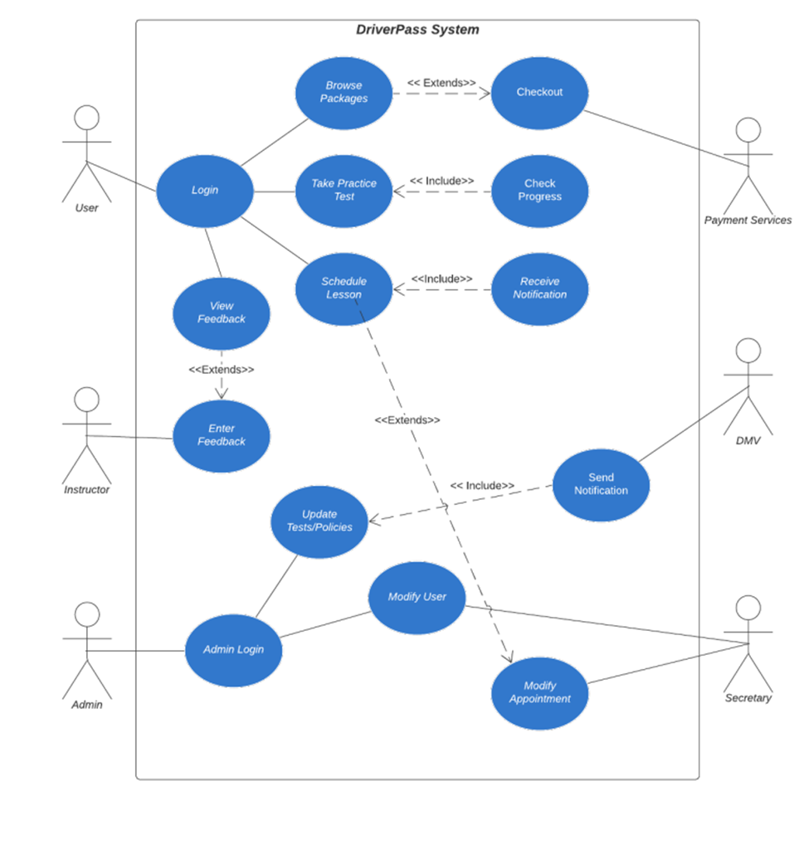
Use Case Diagram
Notes:
The different users in this system are the admin, the customer (user), the DMV, secretary and the
instructor. The actions that can be performed are to notify the company of DMV law
changes, the users can make/modify appointments, the system will track all
appointments, the admin can oversee all the system operations, users can view the
appointment schedule and users can log in. The DriverPass users will need to have the
ability to reset their own passwords as well as the IT office will also need that access as
well. The user (customer) will need the ability to view their training progress and view
the any other training available. The instructor will need to be able to view the user’s
progress and have access to their profiles.

Slide 4
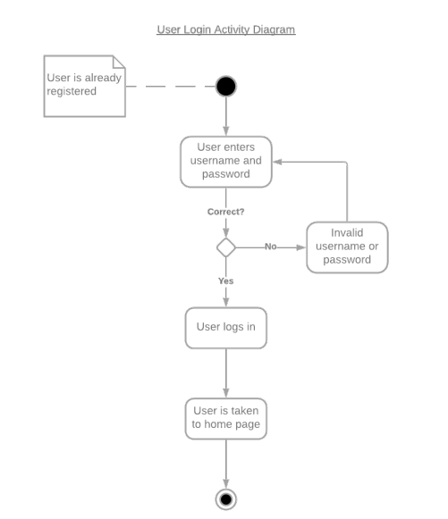
Activity Diagram
Notes:
This is a diagram for a user logging in. The user will first enter their username and a
password that is unique to each person. If the user enters the username and password
Correctly, the user will get logged in and will be taken to the home page. If the username
is entered incorrectly, the process will end and the user will be taken back and prompted to enter the
username and password again.

Slide 5
Security
The system will be hosted on a cloud-based operating service
Usernames and passwords will be unique to each user and case sensitive
Usernames and passwords will be stored in an encrypted database
Users will be locked out of their account after 4 failed log in attempts
Admins can remove/modify users if there is a security threat present
Notes:
Security is an important part of any systems design. We need to make sure that the
security goes beyond just the username and password. Locking a user out of their account after 4 failed log in attempts will ensure part of that security. This will also insure data
integrity and the security of the connection between the system and the users. The users
will have the ability to reset their own passwords or the IT team will also have the ability
to reset a user’s password as well.

Slide 6
System Limitations
5-month time limit
No budget provided
System is web based and may not be immediately available for mobile users
Notes:
This design does have some system limitations. The project having a timeline of five
months is a limitation because that is not a huge length of time for a project to be
completed. The system may not be able to work on a mobile device. Now with the progression of technology I think
that having mobile access would be a huge benefit for DriverPass. The users are not able
to select the driving instructor they want, and this could be an issue if there are certain drivers
the users want or don’t want to be paired with. Overall, I do think the system has
limitations but I think it is a good system and with some time it will be great.

